Slide 1
Mehran S. Fallah July 2020
Programming Languages
Session XII
Types

Slide 2
Introduction
Software engineering recognizes a broad range of methods for helping ensure that a system behaves correctly with respect to the specification of its desired behavior.
As software systems (components) are indeed programs written in a programming language, it would be a good idea to add processes to the language so that it can be assured that programs are certainly well-behaved.
In fact, programming languages are to help programmers organize computational constructs and use them correctly.
Many programming languages organize data and computations into collections called types, which represent the kinds of values that may be computed.
The type system of a programming language is then defined to be a tractable syntactic method for proving the absence of certain program behaviors by classifying phrases according to their types.
Type systems are by far the most popular and best established instance of lightweight formal methods for guaranteeing the correct behavior of programs.
In this session, we look at the reasons for using types and type systems in programming languages. We also introduce the concept of type safety and illustrate it by an example.

Slide 3
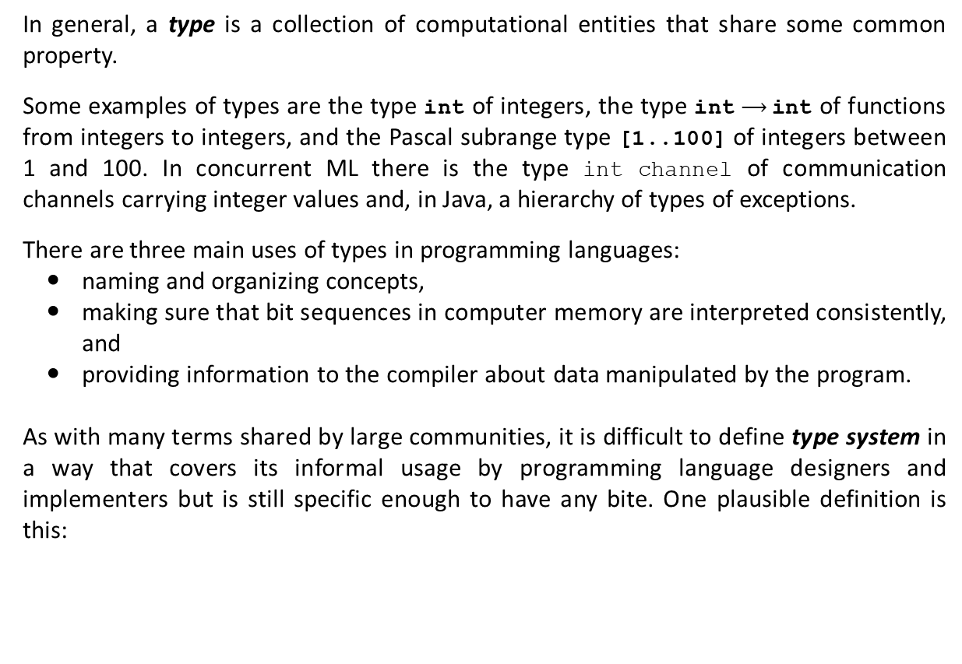
Types and Type Systems
In general, a type is a collection of computational entities that share some common property.
Some examples of types are the type int of integers, the type int$⟶$int of functions from integers to integers, and the Pascal subrange type [1..100] of integers between 1 and 100. In concurrent ML there is the type int channel of communication channels carrying integer values and, in Java, a hierarchy of types of exceptions.
There are three main uses of types in programming languages:
naming and organizing concepts,
making sure that bit sequences in computer memory are interpreted consistently, and
providing information to the compiler about data manipulated by the program.
As with many terms shared by large communities, it is difficult to define type system in a way that covers its informal usage by programming language designers and implementers but is still specific enough to have any bite. One plausible definition is this:
A type system is a tractable syntactic method for proving the absence of certain program behaviors by classifying phrases according to the kinds of values they compute.

Slide 4
Types and Type Systems (Ctd.)
A number of points deserve comment. First, this definition identifies type systems as tools for reasoning about programs.
More generally, the term type systems (or type theory) refers to a much broader field of study in logic, mathematics, and philosophy. Type systems in this sense were first formalized in the early 1900s as ways of avoiding the logical paradoxes.
Another important element in the above definition is its emphasis on classification of terms—syntactic phrases—according to the properties of the values that they will compute when executed. A type system can be regarded as calculating a kind of static approximation to the run-time behaviors of the terms in a program.
The word static is sometimes added explicitly—we speak of a statically typed programming language, for example—to distinguish the sorts of compile-time analyses we are considering here from the dynamic or latent typing found in languages such as Scheme, where run-time type tags are used to distinguish different kinds of structures in the heap.
Being static, type systems are necessarily also conservative: they can categorically prove the absence of some bad program behaviors, but they cannot prove their presence, and hence they must also sometimes reject programs that actually behave well at run time.

Slide 5
Types and Type Systems (Ctd.)
A related point is that the relatively straightforward analyses embodied in most type systems are not capable of proscribing arbitrary undesired program behaviors; they can only guarantee that well-typed programs are free from certain kinds of misbehavior.
For example, most type systems can check statically that the arguments to primitive arithmetic operations are always numbers, that the receiver object in a method invocation always provides the requested method, etc., but not that the second argument to the division operation is non-zero, or that array accesses are always within bounds.
The bad behaviors that can be eliminated by the type system in a given language are often called run-time type errors, or type errors for short.
A type error occurs when a computational entity, such as a function or a data value, is used in a manner that is inconsistent with the concept it represents.
It is important to keep in mind that the set of bad behaviors is a per-language choice: each type system comes with a definition of the behaviors it aims to prevent.
The soundness of each type system must be judged with respect to its own set of run-time type errors.

Slide 6
Types and Type Systems (Ctd.)
The sorts of bad behaviors detected by type analysis are not restricted to low-level faults like invoking non-existent methods or using an integer value as a function.
Type systems are also used to enforce higher-level modularity properties and to protect the integrity of user-defined abstractions. Violations of information hiding, such as directly accessing the fields of a data value whose representation is supposed to be abstract, are run-time type errors in exactly the same way as, for example, treating an integer as a pointer and using it to crash the machine.
The simplest kind of type error to understand is a machine instruction that results in a hardware error. For example, executing a function call x() is a type error if x is not a function. If x is an integer variable with value 256, for example, then executing x() may cause a hardware interrupt. Another example of a hardware type error occurs in executing an operation float_add(3,4.5) where the hardware floating-point unit is invoked on an integer argument 3.
Some type errors do not cause a hardware fault or interrupt, but they reflect an unintended meaning (semantics). For example, an operation int_add(3,4.5) is a type error, as int_add is an integer operation and is applied here to a floating-point number. Most hardware would perform this operation. Because the bits used to represent the floating-point number 4.5 represent an integer that is not mathematic-ally related to 4.5.

Slide 7
Types and Type Systems (Ctd.)
The reason why many people find the concept of type error confusing is that type errors generally depend on the concepts defined in a program or programming language, not the way that programs are executed on the underlying hardware.
It is just as much of a type error to apply an integer operation to a floating-point argument as it is to apply a floating-point operation to an integer argument. It does not matter which causes a hardware interrupt on any particular computer.
Type checkers, which are implementations of type systems, are typically built into compilers or linkers. This implies that they must be able to do their job automatically, that is, they must embody computationally tractable analyses.
However, there is still plenty of room for requiring guidance from the programmer, in the form of explicit type annotations in programs. Usually, these annotations are kept fairly light, to make programs easier to write and read.
But, in principle, a full proof that the program meets some arbitrary specification could be encoded in type annotations; in this case, the type checker would effectively become a proof checker.
By the same token, we are most interested in methods that are not just automatable in principle, but that actually come with efficient algorithms for checking types. However, exactly what counts as efficient is a matter of debate.

Slide 8
Uses of Type Systems
The most obvious benefit of static type checking is that it allows early detection of some programming errors. Errors that are detected early can be fixed immediately, rather than lurking in the code to be discovered much later, when the programmer is in the middle of something else, or even after the program has been deployed.
Moreover, errors can often be pinpointed more accurately during type checking than at run time.
In practice, static type checking exposes a surprisingly broad range of errors. Programmers working in richly typed languages often remark that their programs tend to “just work” once they pass the type checker, much more often than they feel they have a right to expect.
One possible explanation for this is that not only trivial mental slips (e.g., forgetting to convert a string to a number before taking its square root), but also deeper conceptual errors (e.g., neglecting a boundary condition in a complex case analysis, or confusing units in a scientific calculation), will often manifest as inconsistencies at the level of types.
The strength of this effect depends on the expressiveness of the type system and on the programming task in question.

Slide 9
Uses of Type Systems (Ctd.)
Another important way in which type systems support the programming process is by enforcing disciplined programming.
In particular, in the context of large-scale software composition, type systems form the backbone of the module languages used to package and tie together the components of large systems.
Types show up in the interfaces of modules (and related structures such as classes); indeed, an interface itself can be viewed as the type of a module, providing a summary of the facilities provided by the module—a kind of partial contract between implementers and users.
Structuring large systems in terms of modules with clear interfaces leads to a more abstract style of design, where interfaces are designed and discussed independently from their eventual implementations. More abstract thinking about interfaces generally leads to better design.
Types are also useful when reading programs. The type declarations in procedure headers and module interfaces constitute a form of documentation, giving useful hints about behavior. Moreover, unlike descriptions embedded in comments, this form of documentation cannot become outdated, since it is checked during every run of the compiler. This role of types is particularly important in module signatures.

Slide 10
Type Systems and Language Safety
The term safe language is, unfortunately, even more contentious than type system.
Informally, though, safe languages can be defined as ones that make it impossible to shoot yourself in the foot while programming. Refining this intuition a little, we could say that a safe language is one that protects its own abstractions.
Every high-level language provides abstractions of machine services. Safety refers to the language’s ability to guarantee the integrity of these abstractions and of higher-level abstractions introduced by the programmer using the definitional facilities of the language.
For example, a language may provide arrays, with access and update operations, as an abstraction of the underlying memory. A programmer using this language then expects that an array can be changed only by using the update operation on it explicitly—and not, for example, by writing past the end of some other data structure. Similarly, one expects that lexically scoped variables can be accessed only from within their scopes, that the call stack truly behaves like a stack, etc.
Language safety is not the same thing as static type safety. Language safety can be achieved by static checking, but also by run-time checks that trap nonsensical operations just at the moment when they are attempted and stop the program or raise an exception. For example, Scheme is a safe language, even though it has no static type system.

Slide 11
Type Systems and Language Safety (Ctd.)
Unsafe languages often provide best effort static type checkers that help programmers eliminate at least the most obvious sorts of slips, but such languages do not qualify as type-safe either, according to our definition, since they are generally not capable of offering any sort of guarantees that well-typed programs are well behaved—type checkers for these languages can suggest the presence of run-time type errors (which is certainly better than nothing) but not prove their absence.
A programming language is indeed type-safe if no program is allowed to violate its type distinctions.
Sometimes it is not completely clear what the type distinctions are in a specific programming language. However, there are some type distinctions that are meaningful and important in all languages.
For example, a function has a different type from an integer. Therefore, any language that allows integers to be used as functions is not type-safe. Another action that we always consider a type error is to access memory that is not allocated to the program.
The table on the next slide characterizes the safety of some common programming languages.

Slide 12
Type Systems and Language Safety (Ctd.)
Type casts allow a value of one type to be used as another type. In C in particular, an integer can be cast to a function, allowing a jump to a location that does not contain the correct form of instructions to be a C function.
C pointer arithmetic is not type safe. The expression *(p+i) has type A if p is defined to have type A*. Because the value stored in location p+i might have any type, an assignment like x = *(p+i) may store a value of one type into a variable of another type and therefore may cause a type error.
In Pascal, C, and some other languages, the location reached through a pointer may be deallocated (freed) by the programmer. This creates a dangling pointer, a pointer that points to a location that is not allocated to the program. If p is a pointer to an integer, for example, then after we deallocate the memory referenced by p, the program can allocate new memory to store another type of value. The old pointer p allows us to treat the new memory as an integer value, as p still has type int.
Type casts
pointer arithmetic
 | Statically Checked | Dynamically Checked
Safe | ML, Haskell, Java, etc. | Lisp, Scheme, Perl, etc.
Unsafe | C, C++, Pascal, etc.
Explicit Deallocation
Dangling Pointers
almost safe

Slide 13

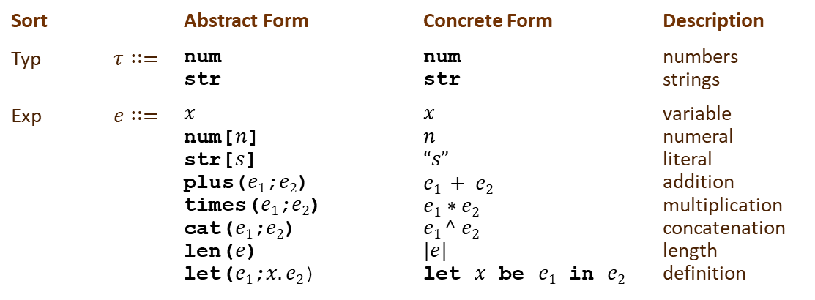
Type-Safe Languages
Here is an example, just to give you an idea of what a type-safe language looks like.
The following summarizes the abstract and concrete syntax of the language NumStr of numbers and strings:
The role of a type system is to impose constraints on the formations of phrases that are sensitive to the context in which they occur. For example, whether the expression plus($x$;num[$n$]) is sensible depends on whether the variable $x$ is restricted to have type num in the surrounding context of the expression.
This example is, in fact, illustrative of the general case, in that the only information required about the context of an expression is the type of the variables within whose scope the expression lies.
Sort |  | Abstract Form | Concrete Form | Description
Typ | $$τ∷=$$ | num str | num str | numbers strings
Exp | $$e∷=$$ | $$x$$ num[$n$] str[$s$] plus($e1$;$e2$) times($e1$;$e2$) cat($e1$;$e2$) len($e$) let($e1$;$x.e2$) | $$x$$ $$n$$ $$“s”$$ $$e1 + e2$$ $$e1∗e2$$ $$e1 ^ e2$$ $$|e|$$ let $x$ be $e1$ in $e2$ | variable numeral literal addition multiplication concatenation length definition

Slide 14









Type-Safe Languages (Ctd.)
Consequently, the statics (static semantics) of NumStr consists of an inductive definition of judgments of the form
$$Γ⊢e :τ$$
where $Γ$ is a so-called typing context consisting of hypotheses of the form $x : τ$.
The rules defining the statics of NumStr are as follows:
Lemma 1 (Unicity of Typing). For every typing context $Γ$ and expression $e$, there exists at most one $τ$ such that $e :τ$.
$$\frac{}{Γ, x :τ⊢x :τ}$$
$$\frac{}{Γ⊢\text{str}\text{[}s\text{]}\text{:} \text{str} }$$
$$\frac{}{Γ⊢\text{num}\text{[}n\text{]}\text{: }\text{num} }$$
$$\frac{Γ⊢e_{1 }\text{: }\text{num} Γ⊢e_{2} \text{: }\text{num}}{Γ⊢\text{plus}\text{(}e1\text{;}e2\text{)}\text{:} \text{num} }$$
$$\frac{Γ⊢e_{1}\text{: }\text{num} Γ⊢e_{2}\text{: }\text{num}}{Γ⊢\text{times}\text{(}e1\text{;}e2\text{)}\text{: }\text{num} }$$
$$\frac{Γ⊢e_{1}\text{: }\text{str} Γ⊢e_{2}\text{: }\text{str}}{Γ⊢\text{cat}\text{(}e1\text{;}e2\text{)}\text{: }\text{str} }$$
$$\frac{Γ⊢e \text{: }\text{str}}{Γ⊢\text{len}\text{(}e\text{)}\text{: }\text{num} }$$
$$\frac{Γ⊢e_{1} : τ_{1} Γ, x :τ_{1}⊢e_{2} : τ_{2}}{Γ⊢\text{let}\text{(}e1\text{;}x.e2\text{)}: τ_{2}}$$

Slide 15






Type-Safe Languages (Ctd.)
Lemma 2 (Inversion for Typing). Suppose that $Γ⊢e : τ$. If $e=$plus($e1$;$e2$), then $τ =$ num, ${Γ⊢e}_{1}\text{: }\text{num}$, and${ Γ⊢e}_{2}\text{: }\text{num}$ and similarly for the other constructs of the language.
Lemma 3 (Weakening). If $Γ⊢e^{′} :τ′$, then , $Γ, x :τ⊢e^{′} :τ′$ for any $x∉dom(Γ)$ and any type $τ$ .
Lemma 4 (Substitution). If , $Γ, x :τ⊢e^{′} :τ′$ and $Γ⊢e :τ$, , then $Γ⊢\left[x↦e\right]e^{′} :τ′$.
You can derive the type of the expression
$e=\text{let}\text{(}\text{plus}\text{(}\text{num}\text{[}1\text{];}\text{num}\text{[}2\text{]);}x.\text{times}\text{(}x\text{;}\text{num}\text{[}3\text{])}$ $\text{)}$
in an empty typing context using the given typing rules as follows ($e$ is well-typed or typable):
However, you cannot derive any type for the expression
$e=\text{let}\text{(}\text{plus}\text{(}\text{num}\text{[}1\text{];}\text{num}\text{[}2\text{]);}x.\text{len}\text{(}x\text{)}$ $\text{)}$.
The expression $e$ is said to be ill-typed.
$$\frac{}{∅⊢\text{num}\text{[}1\text{]}\text{: }\text{num} }$$
$$\frac{}{∅⊢\text{num}\text{[}2\text{]}\text{: }\text{num} }$$
$$\frac{}{∅, x :\text{num}⊢x \text{: }\text{num} }$$
$$\frac{}{∅, x :\text{num}⊢\text{num}\text{[}3\text{]}\text{: }\text{num} }$$
$$∅⊢\text{plus}\text{(}\text{num}\text{[}1\text{];}\text{num}\text{[}2\text{])}\text{:} \text{num}$$
$$∅, x :\text{num}⊢\text{times}\text{(}x\text{;}\text{num}\text{[}3\text{])}\text{:} \text{num}$$
$$∅⊢\text{let}\text{(}\text{plus}\text{(}\text{num}\text{[}1\text{];}\text{num}\text{[}2\text{]);}x.\text{times}\text{(}x\text{;}\text{num}\text{[}3\text{]))}:\text{num}$$

Slide 16











Type-Safe Languages (Ctd.)
The operational semantics of NumStr is given by a transition system whose states are closed expressions. All states are initial. The final states are values, which represent the completed computations. The judgment “$e$ val,” which states that $e$ is a value, is inductively defined by the following rules:
The transition judgment, $e⟶e′$ between states is inductively defined by the following rules:
$$\frac{}{\text{num}\text{[}n\text{]} \text{val}}$$
$$\frac{}{\text{str}\text{[}s\text{]} \text{val}}$$
$$\frac{n_{1}+n_{2}=n \text{n}\text{at}}{\text{plus}\text{(}\text{num}\text{[}n_{1}\text{];}\text{num}\text{[}n_{2}\text{])}⟶\text{num}\text{[}n\text{]}}$$
$$\frac{e_{1}⟶e_{1}^{′}}{\text{plus}\text{(}e_{1}\text{;}e_{2}\text{)}⟶\text{plus}\text{(}e_{1}^{′}\text{;}e_{2}\text{)}}$$
$$\frac{e_{1} \text{val} e_{2}⟶e_{2}^{′}}{\text{plus}\text{(}e_{1}\text{;}e_{2}\text{)}⟶\text{plus}\text{(}e_{1}\text{;}e_{2}^{′}\text{)}}$$
$$\frac{s_{1} ^{ s}_{2}=s \text{str}}{\text{cat}\text{(}\text{str}\text{[}s_{1}\text{];}\text{str}\text{[}s_{2}\text{])}⟶\text{str}\text{[}s\text{]}}$$
$$\frac{e_{1}⟶e_{1}^{′}}{\text{cat}\text{(}e_{1}\text{;}e_{2}\text{)}⟶\text{cat}\text{(}e_{1}^{′}\text{;}e_{2}\text{)}}$$
$$\frac{e_{1} \text{val} e_{2}⟶e_{2}^{′}}{\text{cat}\text{(}e_{1}\text{;}e_{2}\text{)}⟶\text{cat}\text{(}e_{1}\text{;}e_{2}^{′}\text{)}}$$
$$\frac{e_{1}⟶e_{1}^{′}}{\text{let}\text{(}e1\text{;}x.e2\text{)}⟶\text{let}\text{(}e_{1}^{′}\text{;}x.e2\text{)}}$$
$$\frac{e_{1} \text{val}}{\text{let}\text{(}e1\text{;}x.e2\text{)}⟶\left[x↦e_{1}\right]e_{2}}$$

Slide 17
Type-Safe Languages (Ctd.)
Most contemporary programming languages are type-safe, or strongly typed. Informally, this means that certain kinds of mismatches cannot arise during execution.
For example, type safety for NumStr states that it will never arise that a number is to be added to a string, or that two numbers are to be concatenated, neither of which is meaningful.
In general, type safety expresses the coherence between the statics (static semantics) and the dynamics (semantics) of the language.
The statics may be seen as predicting that the value of an expression will have a certain form so that the dynamics of that expression is well-defined. Consequently, evaluation cannot get stuck in a state for which no transition is possible, corresponding in implementation terms to the absence of illegal instruction errors at run time.
This is proved by showing that each step of transition preserves typability and by showing that typable states are well-defined.
Consequently, evaluation can never go off into the weeds and hence can never encounter an illegal instruction.

Slide 18
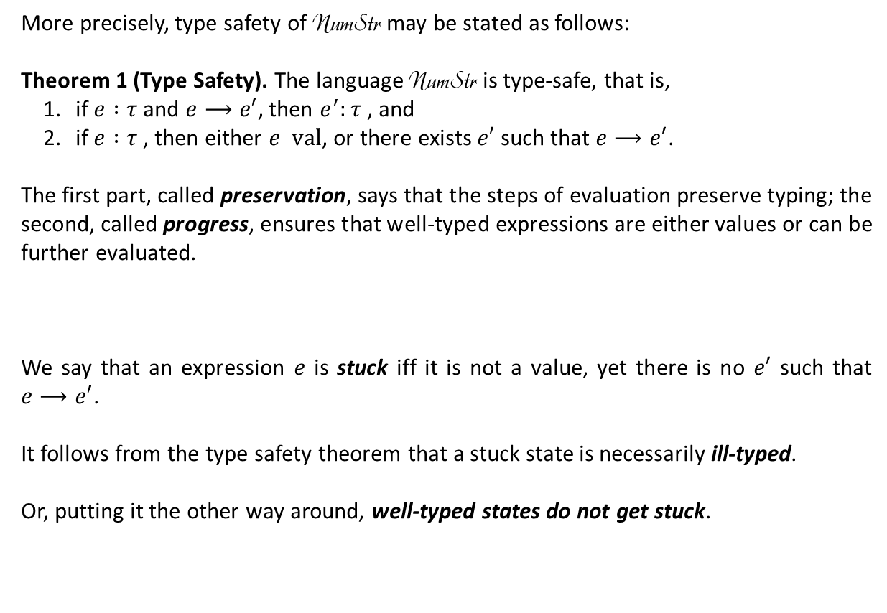
Type-Safe Languages (Ctd.)
More precisely, type safety of NumStr may be stated as follows:
Theorem 1 (Type Safety). The language NumStr is type-safe, that is,
if $e :τ$and $e⟶e′$, then $e^{′}:τ$, and
if $e :τ$, then either $e val$, or there exists $e′$ such that $e⟶e′$.
The first part, called preservation, says that the steps of evaluation preserve typing; the second, called progress, ensures that well-typed expressions are either values or can be further evaluated.
We say that an expression $e$ is stuck iff it is not a value, yet there is no $e′$ such that $e⟶e′$.
It follows from the type safety theorem that a stuck state is necessarily ill-typed.
Or, putting it the other way around, well-typed states do not get stuck.
Type Safety = Preservation + Progress

Slide 19
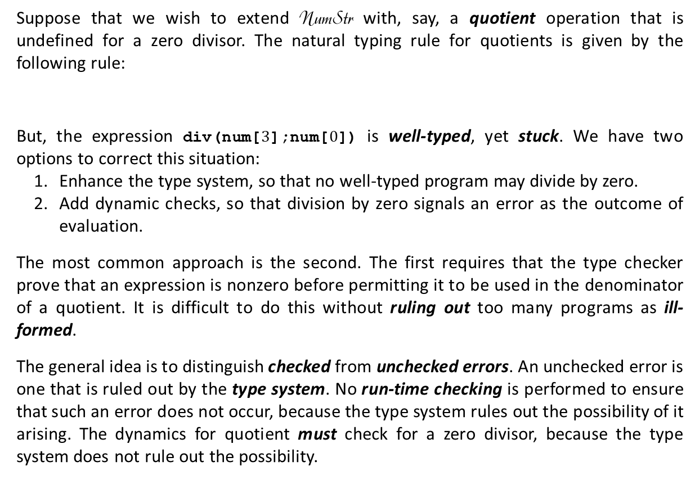

Type-Safe Languages (Ctd.)
Suppose that we wish to extend NumStr with, say, a quotient operation that is undefined for a zero divisor. The natural typing rule for quotients is given by the following rule:
But, the expression $\text{div}\text{(}\text{num}\text{[}3\text{];}\text{num}\text{[}0\text{])}$ is well-typed, yet stuck. We have two options to correct this situation:
Enhance the type system, so that no well-typed program may divide by zero.
Add dynamic checks, so that division by zero signals an error as the outcome of evaluation.
The most common approach is the second. The first requires that the type checker prove that an expression is nonzero before permitting it to be used in the denominator of a quotient. It is difficult to do this without ruling out too many programs as ill-formed.
The general idea is to distinguish checked from unchecked errors. An unchecked error is one that is ruled out by the type system. No run-time checking is performed to ensure that such an error does not occur, because the type system rules out the possibility of it arising. The dynamics for quotient must check for a zero divisor, because the type system does not rule out the possibility.
$$\frac{Γ⊢e_{1 }\text{: }\text{num} Γ⊢e_{2} \text{: }\text{num}}{Γ⊢\text{div}\text{(}e1\text{;}e2\text{)}\text{:} \text{num} }$$

Slide 20


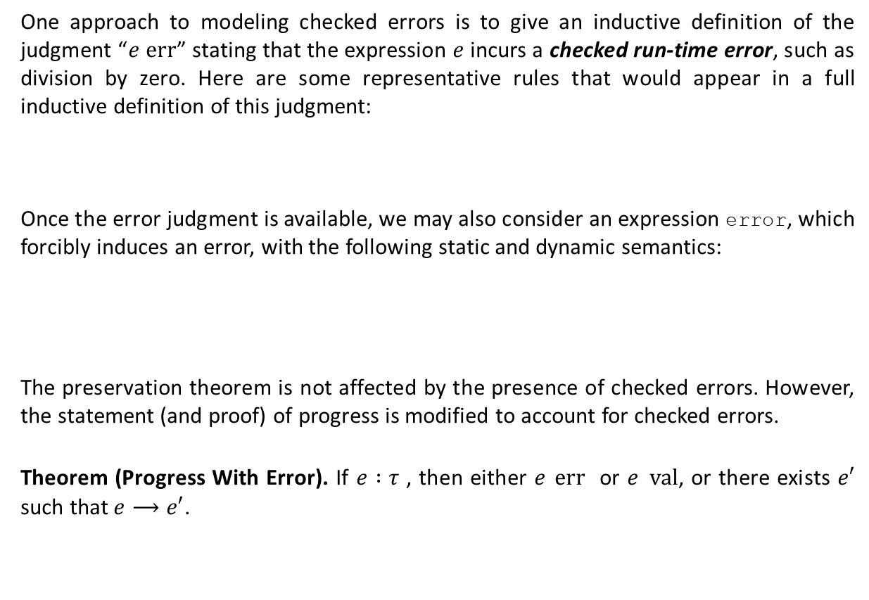



Type-Safe Languages (Ctd.)
One approach to modeling checked errors is to give an inductive definition of the judgment “$e$ err” stating that the expression $e$ incurs a checked run-time error, such as division by zero. Here are some representative rules that would appear in a full inductive definition of this judgment:
Once the error judgment is available, we may also consider an expression error, which forcibly induces an error, with the following static and dynamic semantics:
The preservation theorem is not affected by the presence of checked errors. However, the statement (and proof) of progress is modified to account for checked errors.
Theorem (Progress With Error). If $e :τ$ , then either $e$ err or $e$ val, or there exists $e′$ such that $e⟶e′$.
$$\frac{e_{1} \text{val}}{\text{div}\text{(}e_{1}\text{;}\text{num}\text{[}0\text{])} \text{err}}$$
$$\frac{e_{1} \text{err}}{\text{plus}\text{(}e_{1}\text{;}e_{2}\text{)} \text{err}}$$
$$\frac{e_{1} \text{val} e_{2} \text{err}}{\text{plus}\text{(}e_{1}\text{;}e_{2}\text{)} \text{err}}$$
$$\frac{}{Γ⊢\text{error} \text{:} τ }$$
$$\frac{}{\text{error} \text{err}}$$

Slide 21
Concepts in Programming Languages by John Mitchell (Chapter 6)
Types and Programming Languages by Benjamin Pierce (Chapter 1)
Practical Foundations for Programming Languages by Robert Harper (Chapters 4, 5, and 6)

